Slide 1


Cyber
Protect
Data
Threat
Security
Attack
Firewall
Malware
PASSWORD ATTACK
(BRUTE-FORCE)
Parallel Simulation using OpenMP
Girija G
23BAI1403

Slide 2

INTRODUCTION
Brute-Force Attack?
A method of systematically guessing a password by trying all possible combinations

Slide 3

720 different ways to arrange 6 people in a row to sit
6! = 6 * 5 * 4 * 3 * 2 * 1 = 720

Slide 4

HOW
BRUTE-FORCE WORKS?
Step 1: Take a word from the character set (a-z, 0-9).
Step 2: Compute its MD5 hash.
Step 3: Compare with the target hash.
Step 4: If not matched, try another word.
Step 5: Repeat until the correct password is found.
Exponential complexity:
A 6-character password has
( lowercase + digits (a-z, 0-9))
36⁶ = 2.1 billion combinations!

Slide 5
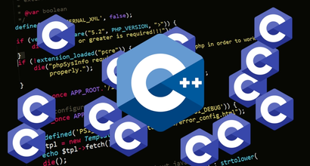





WHY PARALLEL COMPUTING?
Sequential processing takes too long!
Parallelism speeds up brute-force attacks by dividing the workload
OpenMP helps utilize multi-core processors efficiently

Slide 6
USING OPENMP FOR PARALLEL BRUTE-FORCE
OpenMP makes brute-force faster by distributing work among threads.
#pragma omp parallel for splits password attempts across CPU cores.
Instead of one processor checking one password at a time, multiple cores check different passwords simultaneously.

Slide 7
MD5-
MESSAGE DIGEST
ALGORITHM 5
cryptographic hash function that takes an input (message) and produces a 128-bit hash value (32-character hexadecimal).

Slide 8
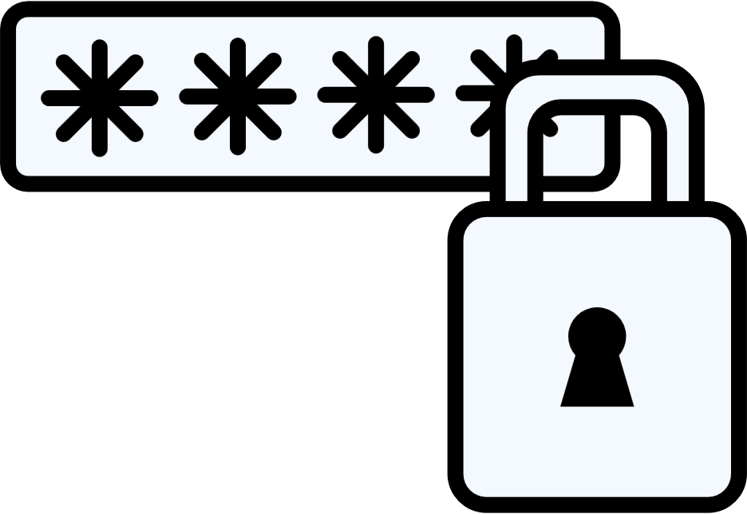
HOW DOES MD5 WORK?
Takes input data (e.g., a password, file, or string).
Processes it through hashing algorithm → Breaks data into fixed-size blocks.
Generates a unique 128-bit hash in hexadecimal format.
Even a small change in input creates a completely different hash (Avalanche Effect).

Slide 9
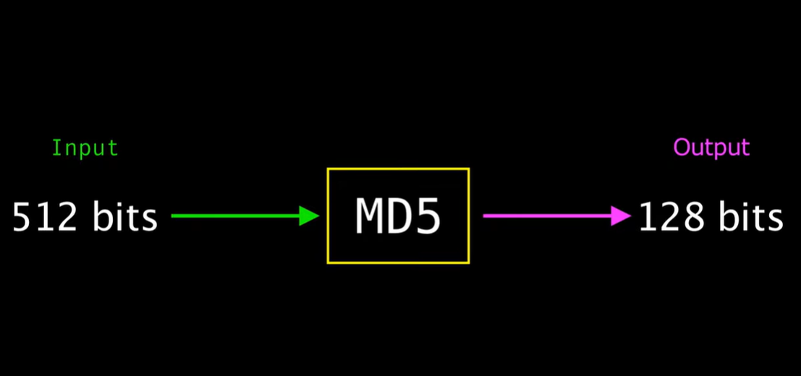



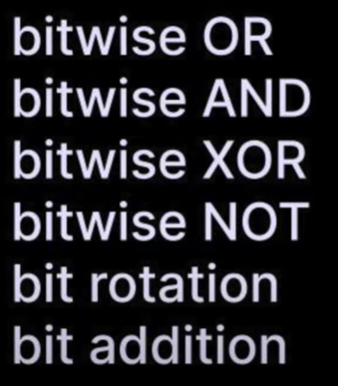
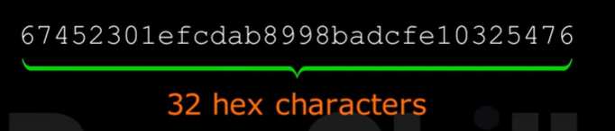
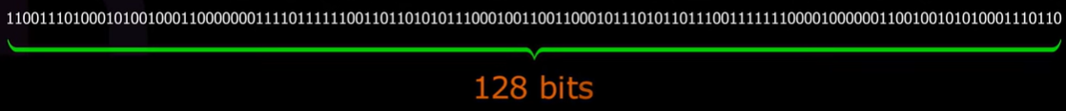
Import hashlib
md5_hash = hashlib.md5("hello world".encode('utf-8')).hexdigest()

Slide 10
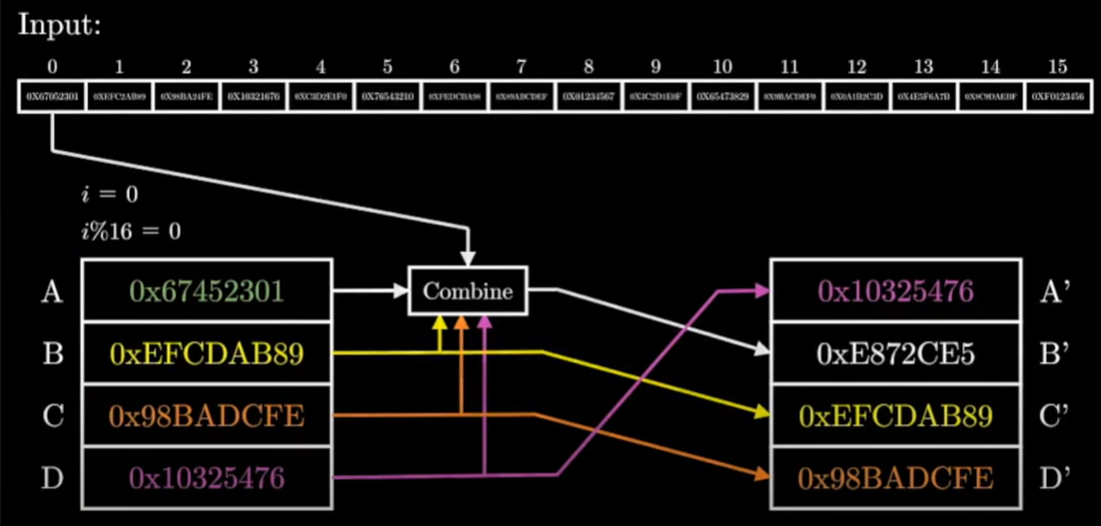

Slide 11

HANDS-ON
https://www.msys2.org/
pacman –Syu
pacman -S mingw-w64-x86_64-gcc
export PATH=/mingw64/bin:$PATH ->temporary
echo 'export PATH=/mingw64/bin:$PATH' >> ~/.bashrc ->perm

Slide 12
HANDS-ON
C:\Program Files\OpenSSL-Win64\bin
cd "/c/Users/dharm/OneDrive/Desktop/GIRIJA DL/CyberSec/cao"
gcc -o final final1.c md5.c –fopenmp
./final
rm -rf /tmp/*
mkdir /c/tmp
export TMPDIR=/c/tmp

Slide 13
HANDS-ON
sprintf(destination, format, value)

Slide 14
Summary
✅ Hashes a 4-digit password using MD5 ✅ Uses OpenMP for parallel brute-force attack ✅ Efficiently stops when the password is found

Slide 15
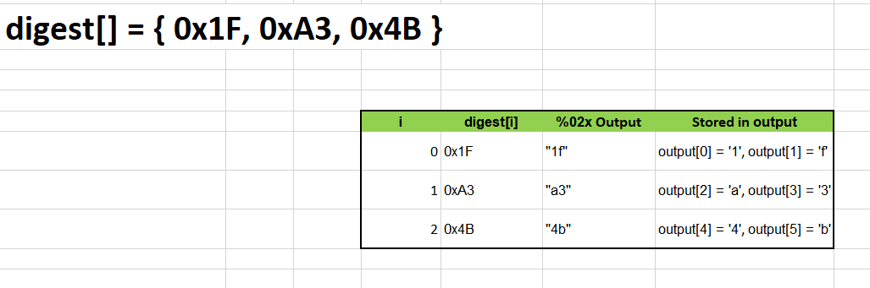

Slide 16
MD5 IS OUTDATED ?
MD5 is outdated and should NEVER be used for password storage.
Instead, use bcrypt, scrypt, or Argon2 to properly secure user credentials.

Slide 17
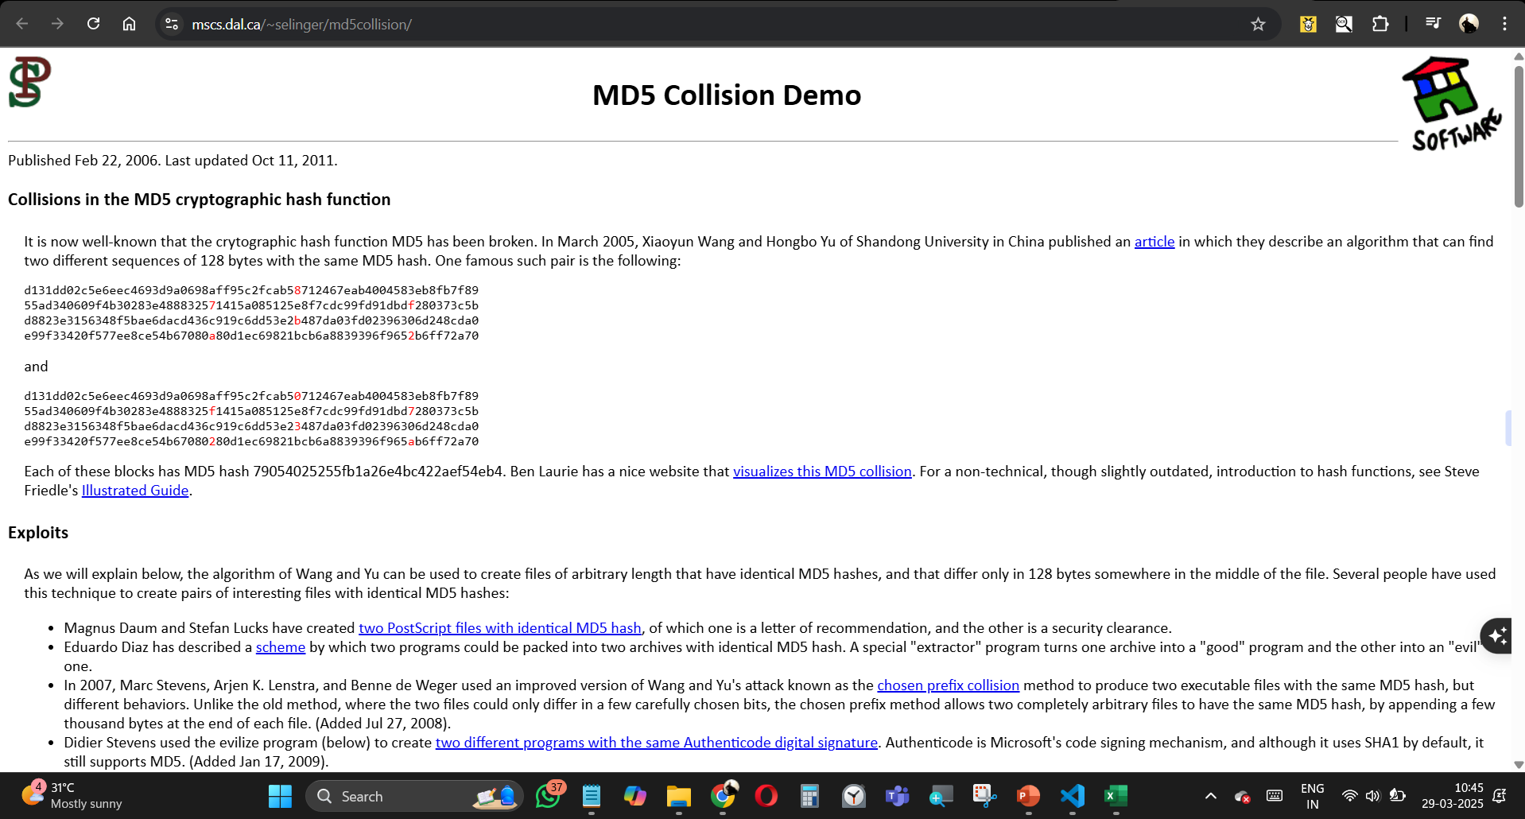

Slide 18
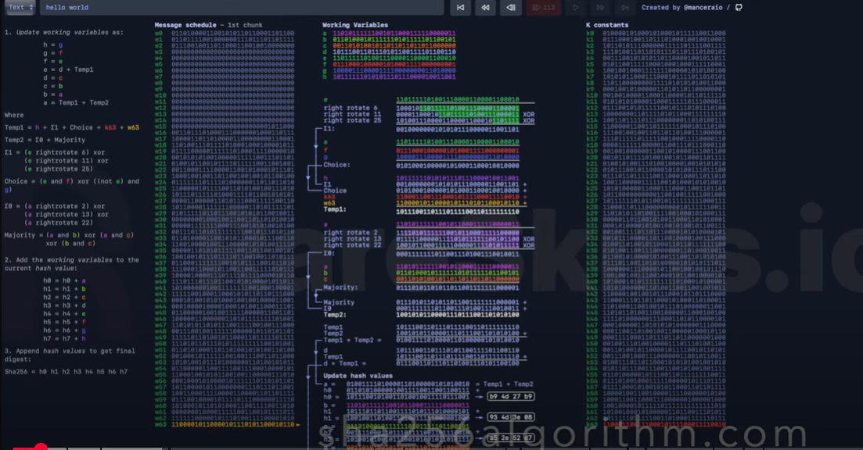

Slide 19


Cyber
Protect
Data
Threat
Security
Attack
Firewall
Malware
THANKYOU
UNLOCKED
Stay Safe, Stay Secure
Thynk Unlimited
@reallygreatsite

